Slide 1
Working with Cascading Style Sheets

Slide 2
Objectives
Review
  Using Inline Styles
  Using Embedded Styles
  Using an External Style Sheet
  Understanding Cascading Order
  Working with Selectors

Slide 3
Objectives
Using IDs and Classes
Sizing Elements
Floating an Element
Working with the div Element
Setting the Display Style
Working with the Box Model
Using Pseudo-Classes and Pseudo-Elements
Applying a Style to a Web Site

Slide 4
Objectives
Positioning Objects with CSS
Working with Overflow and Clipping
Stacking Elements
Working with Different Media
Hiding Elements
Using Print Styles

Slide 5
Cascading Style Sheets
CSS1 introduced styles for the following document features:
  Fonts
  Text
  Color
  Backgrounds
  Block-level Elements

Slide 6
Cascading Style Sheets
CSS2 introduced styles for the following document features:
  Positioning
  Visual Formatting
  Media Types
  Interfaces

Slide 7
Cascading Style Sheets
CSS3 introduces styles for the following document features:
  User Interfaces
  Accessibility
  Columnar layout
  International Features
  Mobile Devices
  Scalable Vector Graphics

Slide 8
Applying a Style Sheet
Three ways to apply a style to an HTML or XHTML document:
  Inline Styles
  Embedded Styles
  External Styles

Slide 9
Cascading Style Sheets
CSS3 introduces styles for the following document features:
  User Interfaces
  Accessibility
  Columnar layout
  International Features
  Mobile Devices
  Scalable Vector Graphics

Slide 10
Using Inline Styles
Inline styles are easy to use and interpret because they are applied directly to the elements they affect.
<element style=“style1: value1; style2:
value2; style3: value3;…”>

Slide 11
Using Embedded Styles
You can embed style definitions in a document head using the following form:
<style>
style declarations
</style>
Where style declarations are the declarations of the different styles to be applied to the document

Slide 12
Using an External Style Sheet
Because an embedded style sheet only applies to the content of the start.htm file, you need to place a style declaration in an external style sheet to apply to the headings in the rest of the Web site
An external style sheet is a text file that contains style declarations
  It can be linked to any page in the site, allowing the same style declaration to be applied to the entire site

Slide 13
Using an External Style Sheet
You can add style comments as you develop an external style sheet
Use the link element to link a Web page to an external style sheet
You can import the content of one style sheet into another

Slide 14
Understanding Cascading Order
You can link a single style sheet to multiple documents in your Web site by using the link element or the @import element
You can also link a single document to several style sheets

Slide 15
Style Precedence
External style sheet
Embedded styles
Inline styles

Slide 16
Style Inheritance
If a style is not specified for an element, it inherits the style of its parent element; This is called style inheritance.

Slide 17
Working with Selectors
CSS allows you to work with a wide variety of selectors to match different combinations of elements
Use contextual selectors to apply a style based on the context in which an element is used

Slide 18
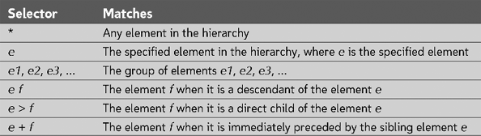
Simple and contextual selectors

Slide 19
Attribute Selectors
Create an attribute selector to select an element based on the element’s attributes
  Checkout w3schools for examples

Slide 20
Attribute Selectors
Create an attribute selector to select an element based on the element’s attributes
  Checkout w3schools for examples

Slide 21
Using IDs and Classes
Use an id to distinguish something, like a paragraph, from the others in a document
  For example, to identify a paragraph as “head”, use the code:
    <p id=“head”>… </p>

Slide 22
Classes
HTML and XHTML require each id be unique– therefore an id value can only be used once in a document
You can mark a group of elements with a common identifier using the class attribute
  <element class=“class”> … </element>

Slide 23
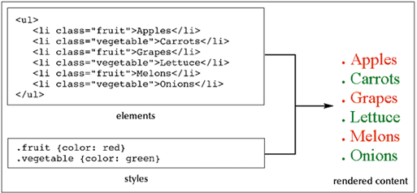
Applying a style to a class

Slide 24
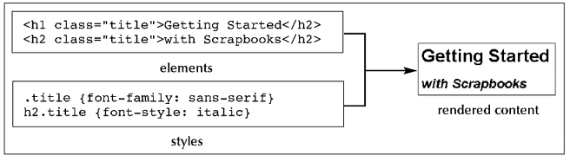
Applying a style to a class and element

Slide 25
Sizing Elements and Floating an Element
You can define the width of columns in a columnar layout using: width: value
You can use CSS to set an element’s height using: height: value
You can float a paragraph using: float: position

Slide 26
Working with the div Element
The div element is a generic block-level element
  <div>
  content
  </div>

Slide 27
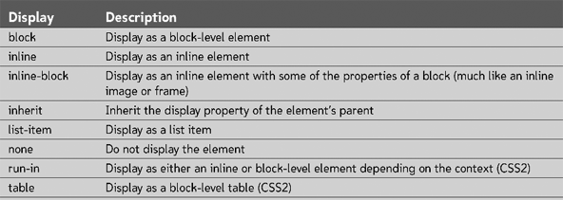
Setting the Display Style
Values of the display style

Slide 28
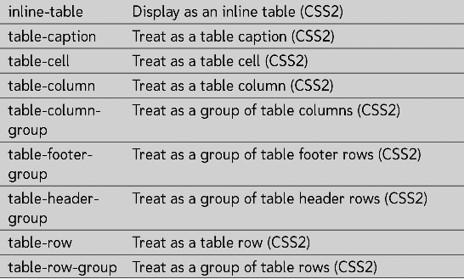
Setting the Display Style
Values of the display style

Slide 29
What is the CSS Box Model?
The “Box Model” is a tool we use to lay out our web pages in a number of individual "boxes" or "containers". When we plan our web page design, we must take into account not only the size of page content, but also the margins, borders, and padding involved.
Before we start building a page, we can plan where everything will go by arranging these boxes on the screen. Our goal is to create a balanced layout, with plenty of "white space" around the content.

Slide 30
Working with the Box Model
The box model is an element composed of four sections:
  Margin
  Border
  Padding
  content

Slide 31
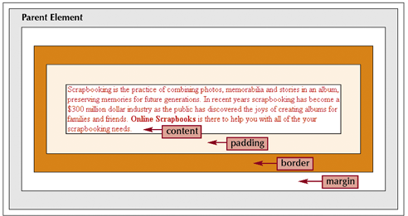
The Box Model

Slide 32
Introducing the <div> tag:
The <div> tag is our basic building block when laying out a page design. By defining the height and width of the <div>, we are "reserving" that amount of space on the screen for whatever content we wish to place there.
The actual content will go inside the opening <div> and closing </div> tags.

Slide 33
When you specify the width and height properties of an element with CSS, you are just setting the width and height of the content area. To know the full size of the element, you must also add the padding, border and margin.

Slide 34
Example <div>:
<head>
<style type="text/css">
.box300 {
width:300px;
height:300px;
border:1px solid black;
}
</style>
</head>
This is a 300 by 300 pixel box
with a 1 px border.
<div class="box300">
This is a 300 by 300 pixel box
with a 1px border.
</div>
This is outside the box.
This is outside the box.
By establishing the box dimensions, we can leave it there as a placeholder until we have our content ready. In the meantime, the rest of the page can be built out with our other content.

Slide 35
Adding padding:
<head>
<style type="text/css">
.box300 {
width:300px;
height:300px;
border:1px solid black;
padding:10px;
}
</style>
</head>
This is a 300 by 300 pixel box
with a 1px border and 10px
padding.
<div class="box300">
This is a 300 by 300 pixel box
with a 1px border and 10px
padding.
</div>
<p>This is outside the box.</p>
This is outside the box.
By adding 10px of padding on all four sides of the content, we have effectively made our box 320px by 320px (321px by 321px with the border).

Slide 36
Adding margin:
<head>
<style type="text/css">
.box300 {
width:300px;
height:300px;
border:1px solid black;
padding:10px;
margin:10px;
}
</style>
</head>
This is a 300 by 300 pixel box
with a 1px border and 10px
padding and 10px margin.
The dotted line here shows where the margin is but it will not show on the actual page.
This is outside the box.
<div class="box300">
This is a 300 by 300 pixel box
with a 1px border and 10px
Padding and 10px margin.
</div>
<p>This is outside the box.</p>
By adding 10px of margin on all four sides of the border, we have now made our box 341px by 341px overall.

Slide 37
Calculating overall dimensions:
When designing our page, we have to calculate how much size a <div> element will consume:
  Total element width = defined width + left padding + right padding + left border + right border + left margin + right margin.
  Total element height = defined height + top padding + bottom padding + top border + bottom border + top margin + bottom margin

Slide 38
Pixels vs. Percent:
The width property can be specified in pixels or in percent. By using "width:50%", we are telling the browser to make the width of the element exactly 50% of the space available.
Using percent instead of pixels can make our page layout highly flexible. For example, we can use the entire screen real estate, no matter what size screen or resolution our web visitor has.

Slide 39
A technique to center a <div>:
Because we don't know what the screen resolution will be for our visitors, it can be challenging to get our pages to display attractively for all viewers.
A useful technique is to set the right and left margins of a <div> to the value "auto". This tells the browser to maintain an equal distance on the right and left, effectively centering the <div> no matter how wide the available area is:
.centerme {
margin:0 auto;
}
This same technique can be used on a <div> element that contains all your page content in order to center your page on the screen, no matter what the screen resolution of your web visitor.

Slide 40
Working with the Box Model
Styles to set padding are similar to styles to set margins:
  padding-top: value
  padding-right: value
  padding-bottom: value
  padding-left: value

Slide 41
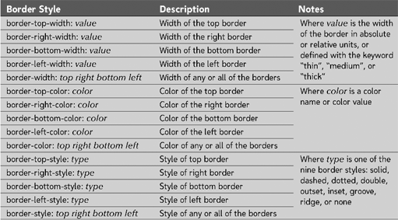
Border Styles

Slide 42
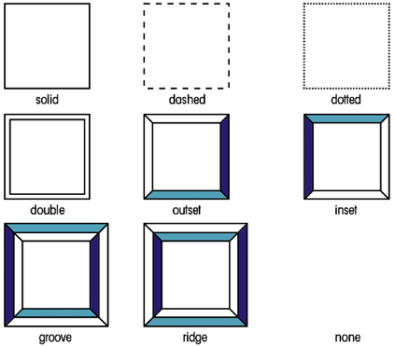
Border Style Types

Slide 43
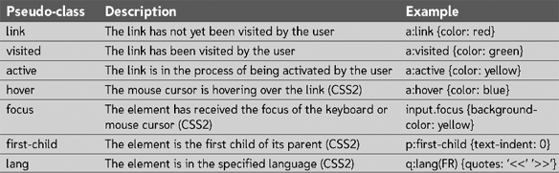
Using Pseudo-Classes and Pseudo-Elements
A pseudo-class is a classification of an element based on its status, position, or current use in the document

Slide 44
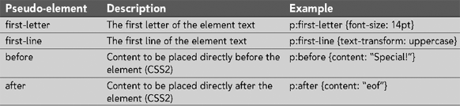
Using Pseudo-Classes and Pseudo-Elements
Rollover effects can be created using pseudo-classes
Pseudo-elements are elements based on information about an element’s content, use or position

Slide 45
Positioning Objects with CSS
The different positioning styles in the original CSS1 specifications were known as CSS-Positioning or CSS-P
To place an element at a specific position on a page use:
  position: type; top: value; right: value;
  bottom: value; left: value;

Slide 46
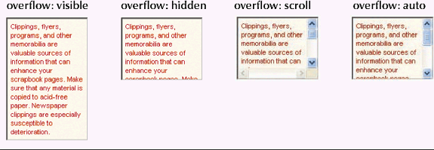
Working with Overflow and Clipping
The overflow property syntax:
  overflow: type

Slide 47
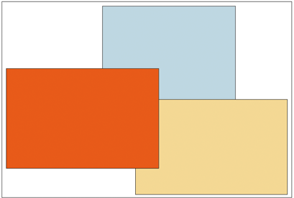
Stacking Elements
Specify stacking order with:
  z-index: value
z-index: 1
z-index: 3
z-index: 2

Slide 48
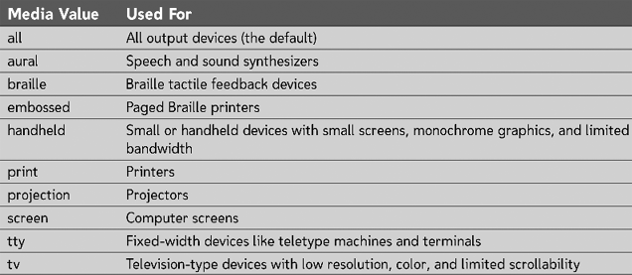
Working with Different Media
Specify output styles for particular devices in the media attribute of the link and style elements

Slide 49
The @media Rule
You can also specify the output media within a style sheet using:
  @media type {style declarations}
  Where media is one of the supported media types
  and style declarations are the styles
  associated with that media type

Slide 50
Media Groups
CSS2 uses media groups to describe basic facets of different media– and to differentiate between different types of media based on the ways they render content
  Continuous or paged
  Visual, aural, or tactile
  Grid (for character grid devices) or bitmap
  Interactive or static

Slide 51
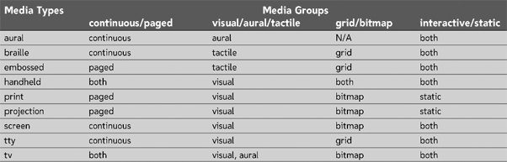
Media Groups

Slide 52
Hiding Elements
Two different styles that allow you to hide elements:
  Display style
  Visibility style

Slide 53
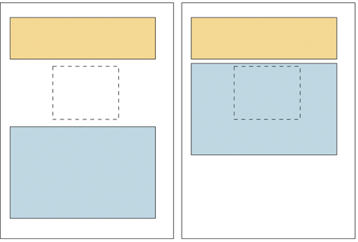
Comparing the visibility and display styles
Visibility hidden
Object is hidden but still is part of the page flow
Display: none
Object is hidden and is removed from the page flow

Slide 54
Using Print Styles
You can specify the size of a page, margins, internal padding, etc. of the page box
Review the Reference Window on page HTML 420 for working with print styles

